Slide 1

A method for pile-up events removal
XII FOOT Collaboration Meeting - 31/05/2022
Giacomo Ubaldi

Slide 2
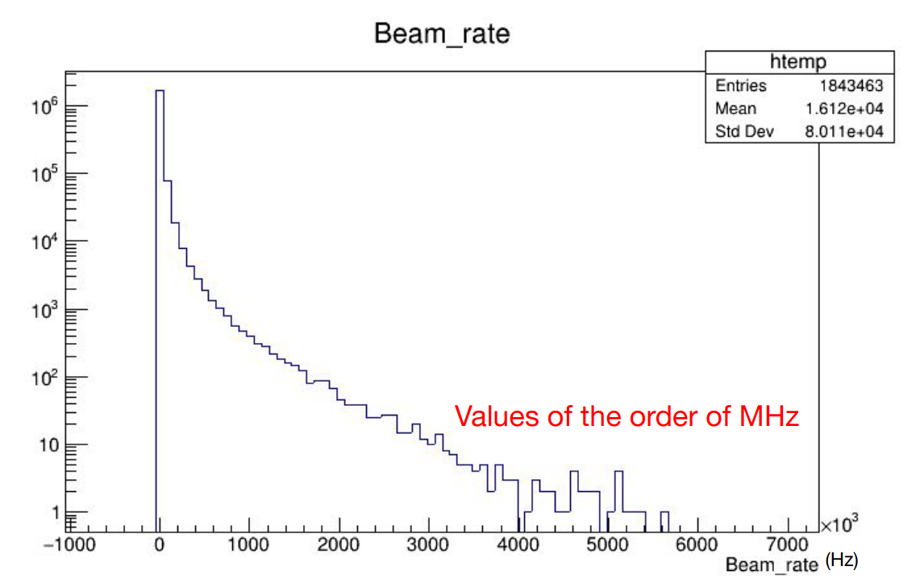
Beam rate
The beam flux must match with the subdetector with lower beam rate
It is the SC which operates at very low rates, i.e. ∼ 10 kHz
What it was seen in the last data taking (GSI - CNAO 2021) is that the beam flux is not constant
Example: CNAO 2021 – 3 nights data taking
10⁶ events
Mean beam rate: 16 kHz
16 kHz
Credits to Marco Bon – FOOT meeting 2 March 2022
G. Ubaldi
It is made by a plastic scintillator 5x5 cm 2 active area and light produced by interaction is collected
by 12 3x3 mm 2 Hamamatsu MPPC

Slide 3
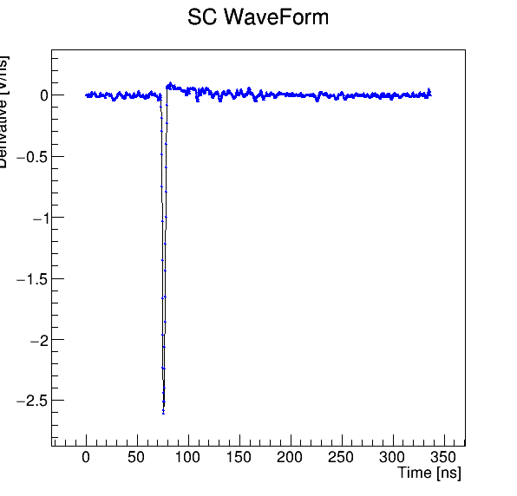
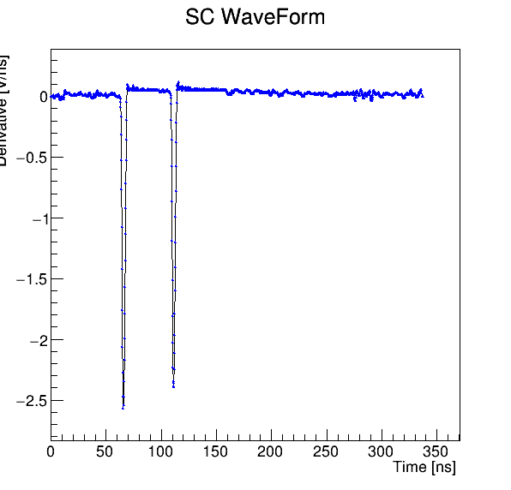
Start Counter Pile Up
→ there is the possibility of pile up events, which are visible in the SC signal
Pile up is the superimposition of more than a projectile in the SC time window, which is ~ 350 ns.
It means that the signal from the SC could have more than one peak in pile up cases:
Single projectile
Pileup projectile
It is fundamental to filter out pile up events because they worsen the overall analysis.
One method to discriminate pile up events is the derivative method, implemented on SHOE
G. Ubaldi

Slide 4

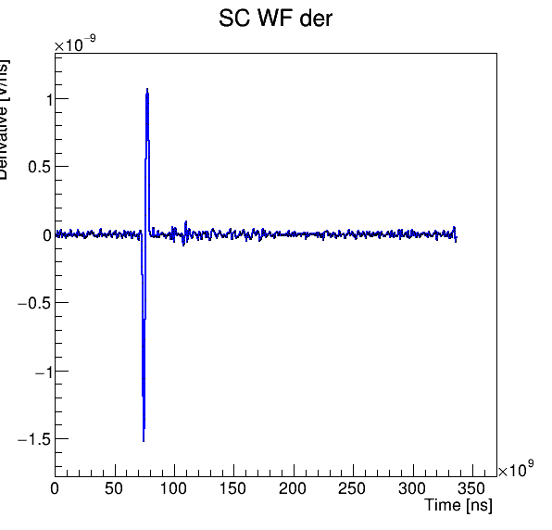
Derivative method, 1
At first, the derivative is made by an algorithm which iterates on every point of the SC signal. The derivative range is of 5 points.
In particular,
∀ point i:
derivation
From every peak of the signal, we obtain two peaks in the derivative,
whose height depends on the steepness of the primitive signal
Baseline noise and overshoot are negligible with this method using 5 consecutive points in the
  elaboration of the derivative.
G. Ubaldi

Slide 5
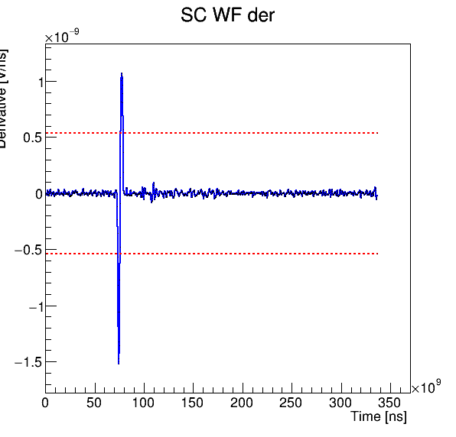
Derivative method, 2
Then a threshold is defined as the 50% of the positive peak height.
thresholds
The symmetric value is used for the negative threshold.
50% is chosen to have a good distance between baseline and so for a good discrimination
G. Ubaldi

Slide 6
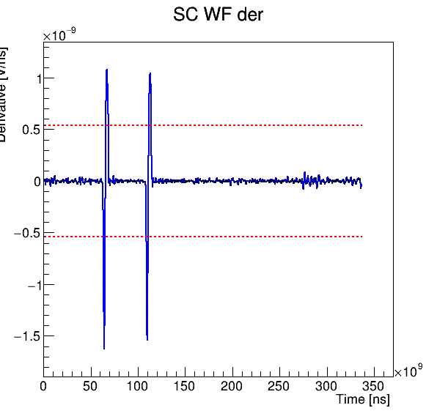
Derivative method, 3
A single signal intersects the threshold lines 4 times: two for the positive and two for the negative ones.
For a pileup signal the intersections are more than 4.
This is at the basis of the constant threshold discrimination method.
2 crosses
4 crosses
2 crosses
4 crosses
Single projectile: 4 crosses
pileup projectile: >4 crosses
G. Ubaldi

Slide 7
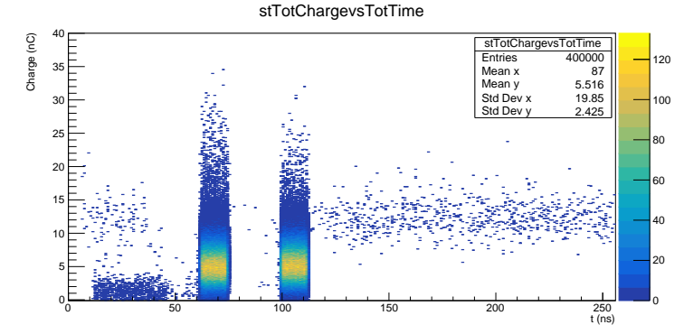
Results, 1
The method was tested on real data taken at GSI of beam of O¹⁶ of 400 MeV/n against a target of C
(DataGSI2021/data_test.00004310.physics_foot.daq.RAW._lb0000._FOOT-RCD._0001.data )
(V*ns)
In the graph time vs charge of all the events, the 2 “columns” are due to minimum bias trigger and trigger fragmentation, which have 2 different response times.
Column width are due to the SC resolution of 12 ns.
G. Ubaldi

Slide 8
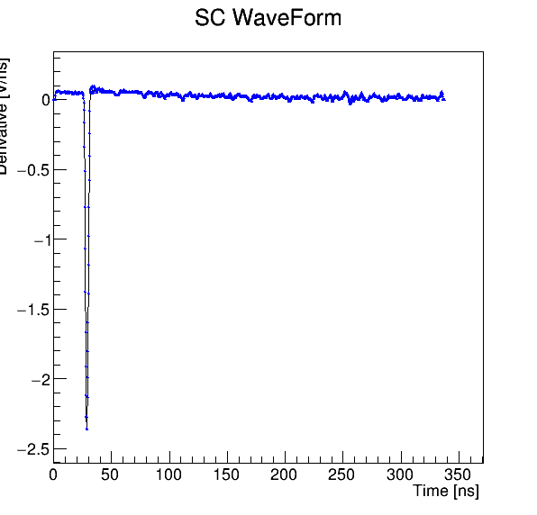
Results, 2
Before and after the “columns”, it is possible to find two different types of events:
(V*ns)
“Hidden” Pileup events:
It is visible only a peak because the previous one was recorded before the start of SC time window.
Pileup events:
The presence of two or more peaks makes a wrong reconstruction of time and charge
n.b: they can be even in the trigger columns
G. Ubaldi

Slide 9
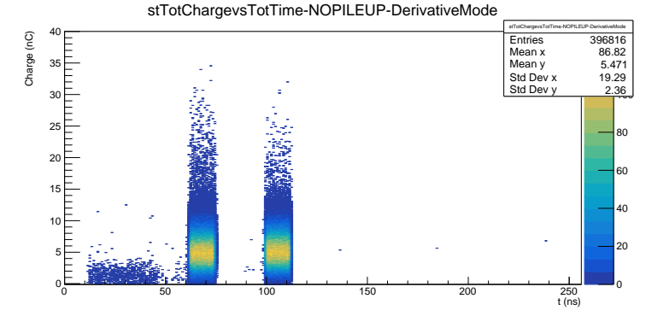
Results, 3
Applying the derivative method, pile up events are filtered out, as it is visible mainly after the “columns”:
(V*ns)
With a removal of 0.8% of the total events
G. Ubaldi

Slide 10
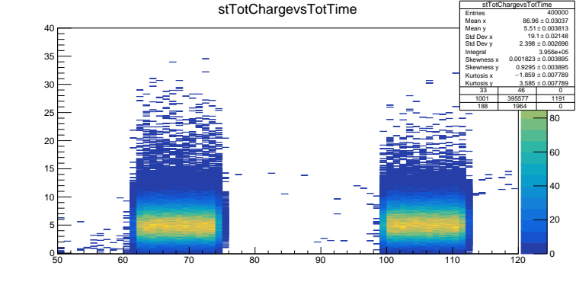
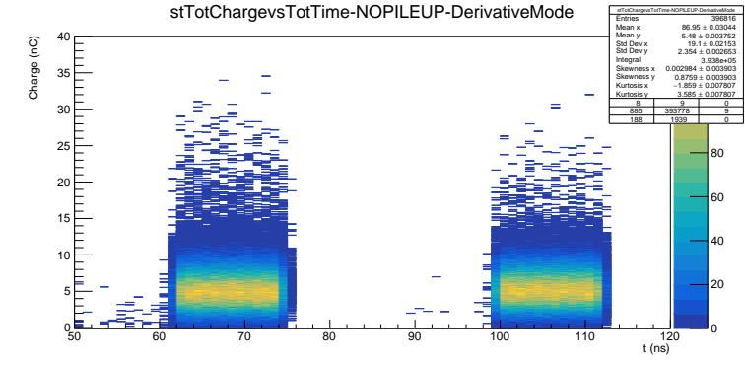
Results, 4
The method is also able to filter out pile up events in the trigger “columns”:
No pile up filter,
events with 50 ns < t < 120 ns: 395577
With pile up filter,
events with 50 ns < t < 120 ns: 393778
with a removal in 50 ns < t < 120 ns of~ 0.5 %
This method is more powerful than just a time cut.
G. Ubaldi

Slide 11
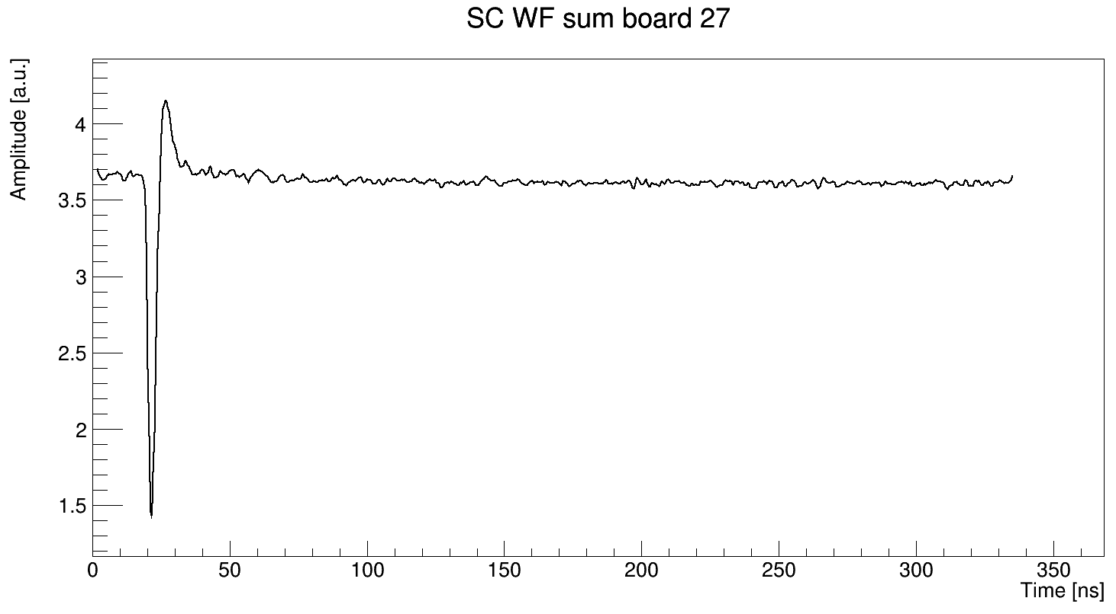
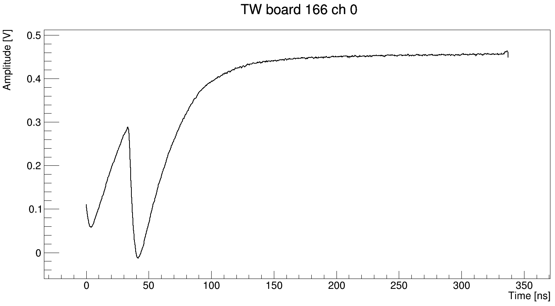
“hidden” pile up events
One of the two peaks is outside the SC time window. Instead, seeing the signal of the same event on the channel of the TW, all peaks can be found.
SC: 1 signal
TW: overimposition of 2 signals
Credits to Roberto Zarrella
To disentangle this pileup, an algorithm which also includes the signal in the TW can be introduced.
However, in first analysis, just a temporal cut on SC with t<50 ns could be enough because they represents little % of all the events.
G. Ubaldi

Slide 12
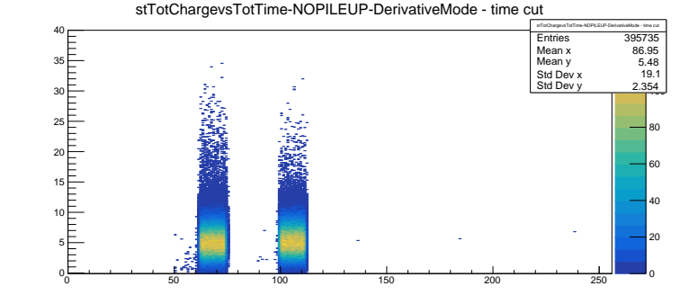
Results, 5
In first analysis, it is possible to filter out hidden pileup applying a cut of t<50ns
(V*ns)
with a removal (derivative + cut) of~ 1.1 % of the total events
G. Ubaldi

Slide 13
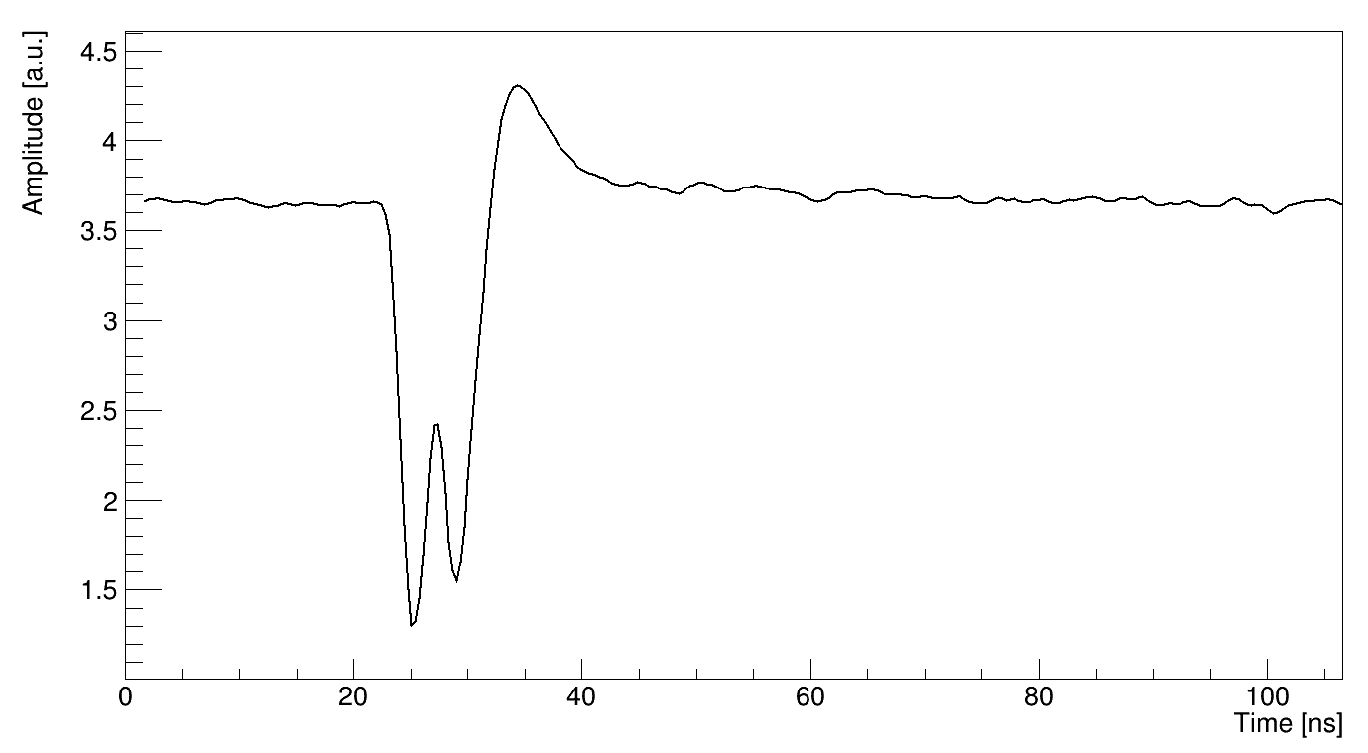
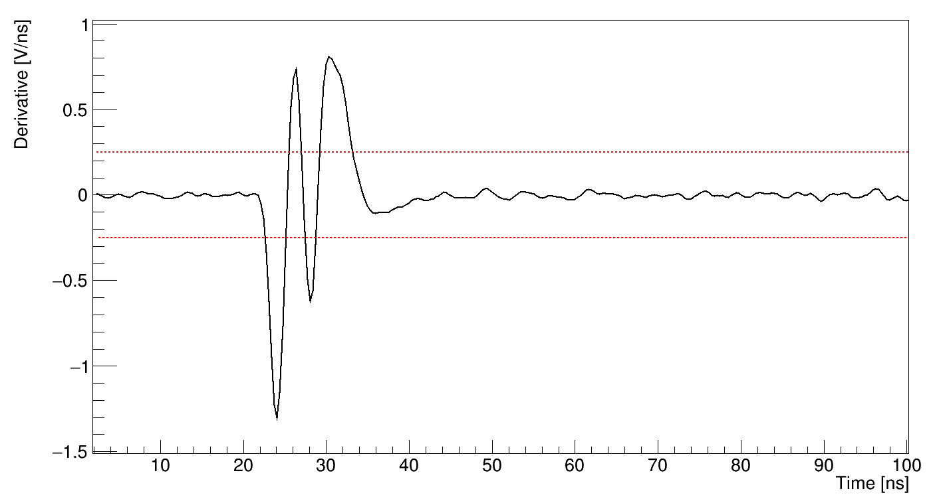
Comments, 1
Pile up events which are temporary very close are successfully discriminated.
derivation
Credits to Roberto Zarrella
More than 4 crosses: pile up event
G. Ubaldi

Slide 14
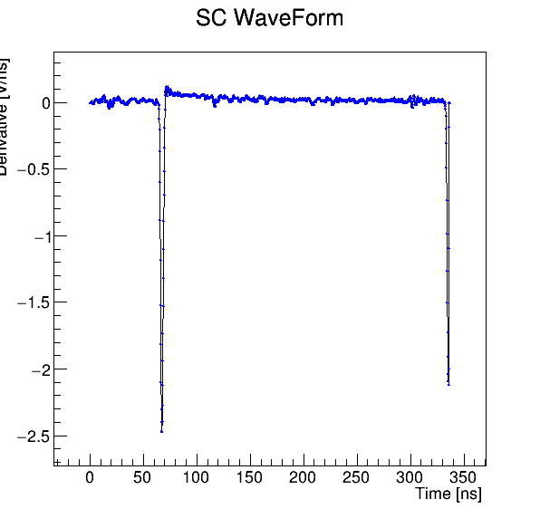
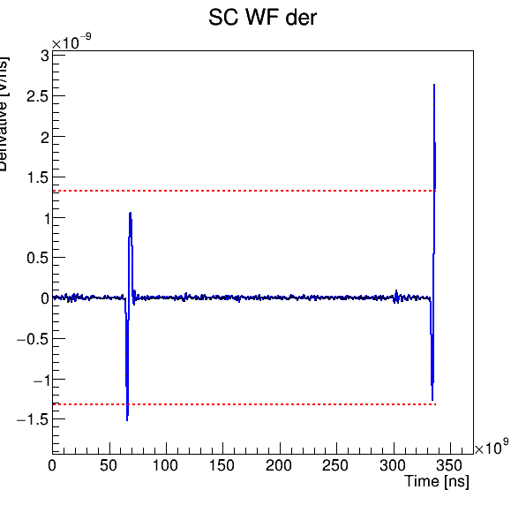
Comments, 2
Some pile up events are not well discriminated when one peak is between the end of the SC time window. The derivative is bad reconstructed and the threshold is too high to have intersections with the signal.
2 crosses
derivation
2 crosses
Only 4 crosses: recognized as single event
The solution could be to decrease the value of the threshold.
However, the presence of this events is very low, ~ 0.004% of the total
G. Ubaldi

Slide 15
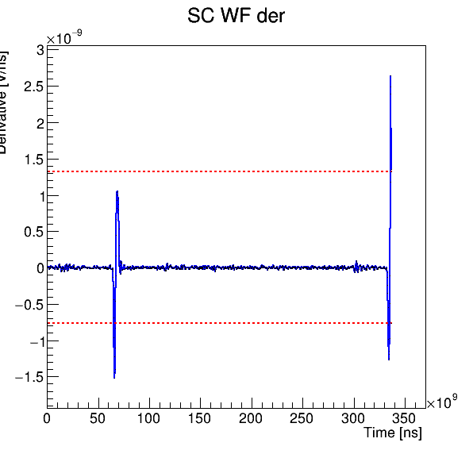
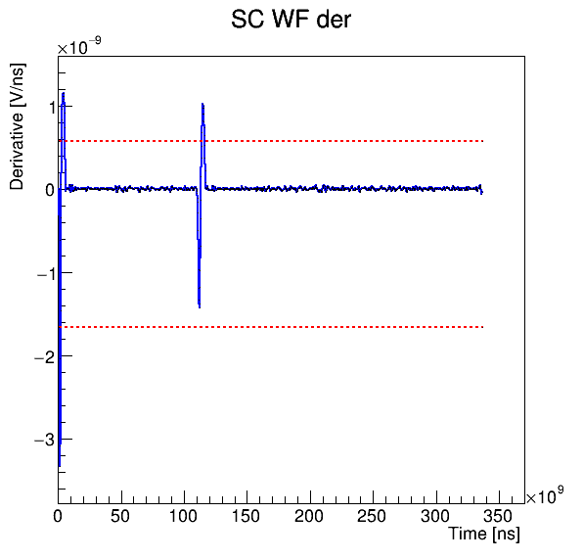
Upgrades
Two separate thresholds for positive and negative peaks
Threshold at 45 % of peak height
More than 4 crosses: pile-up
→ able to discriminate even “particular” cases

Slide 16
Conclusions
The derivative method revelead as valid for pile up discrimination, with a removal of ~ 1 % of total events
Applying this method on SC, we prevent a bad propagation on further detectors, such as TW
It is fast, so it does not worsen monitoring capacity during data taking
Improvements on the algoritm could increase the performace, such as
  new threshold values
  “on-line” pileup counting
G. Ubaldi

Slide 18
Backup slides
G. Ubaldi

Slide 19
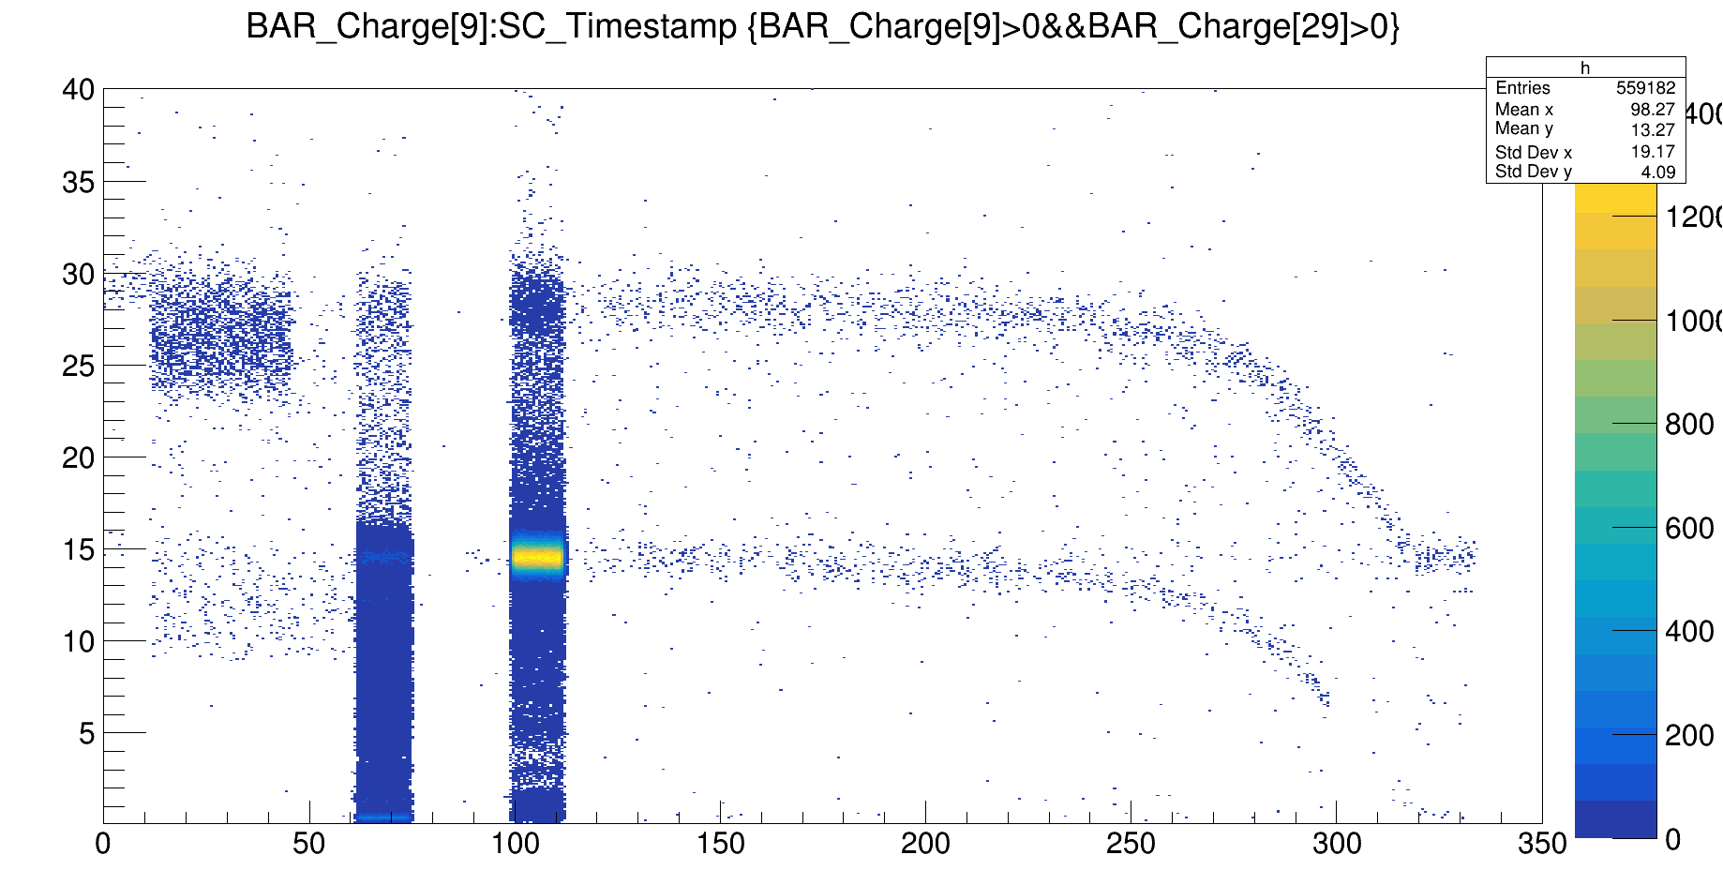
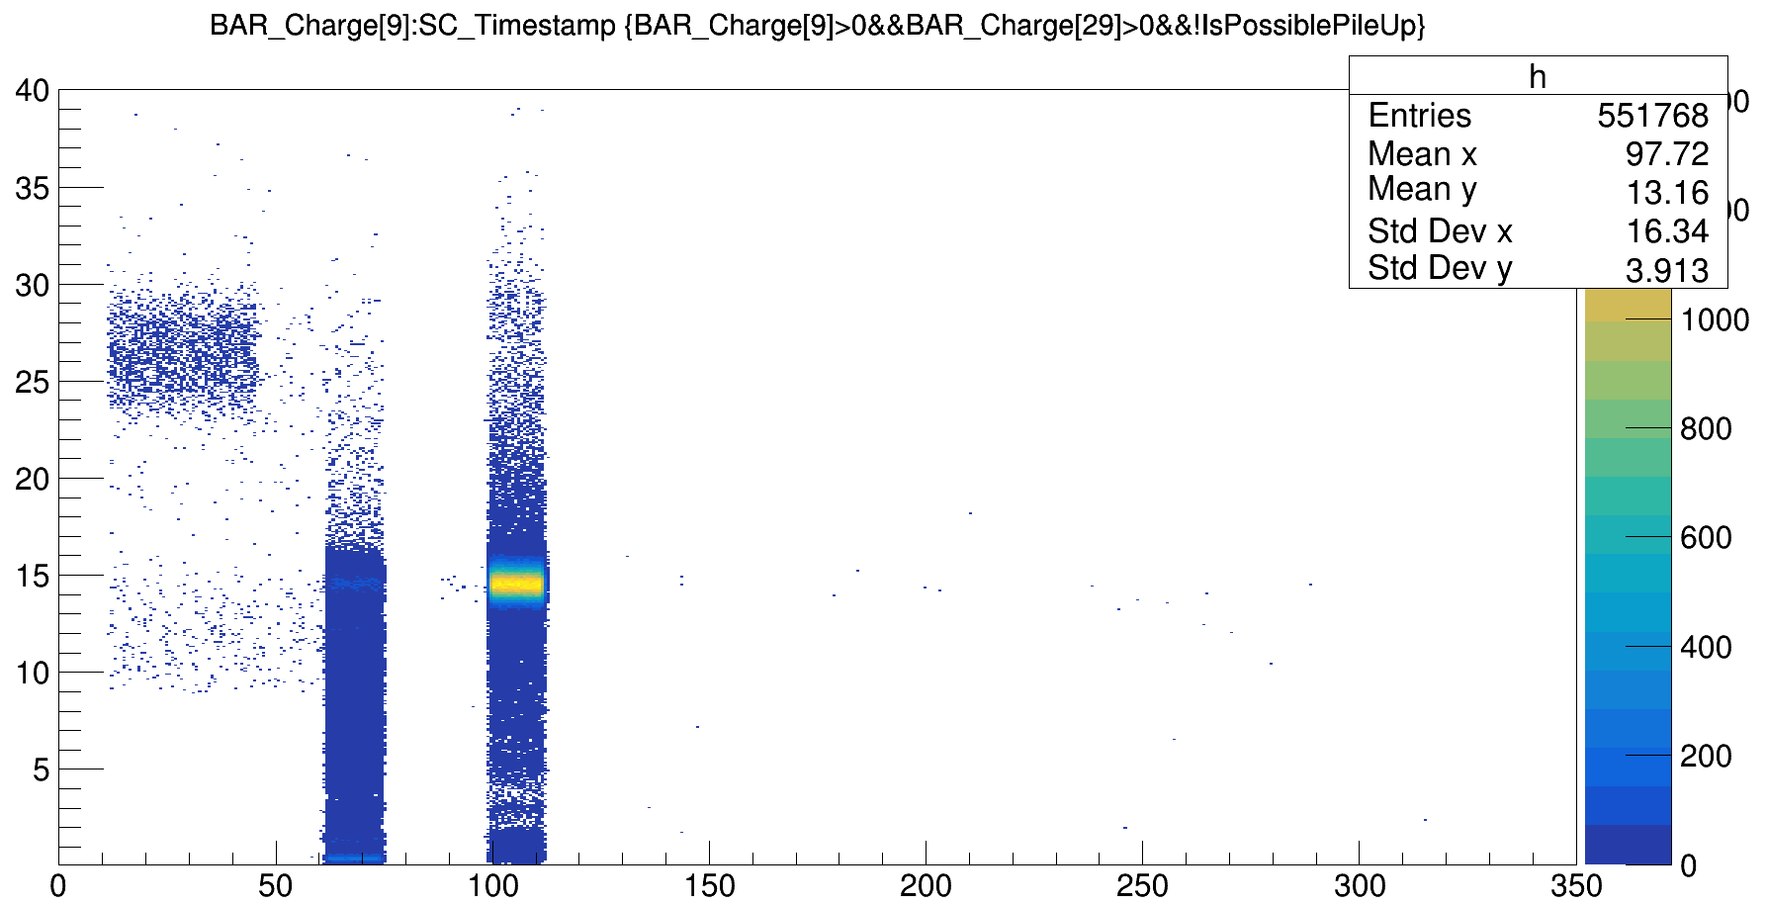
example
DataGSI2021/data_test.00004310.physics_foot.daq.RAW._lb0000._FOOT-RCD._0001.data
Both minimum bias trigger and trigger fragmentation
Charge
PileUp on 600.000 events ~ 1%
t(ns)
Credits to Roberto Zarrella
G. Ubaldi

Slide 20
Implementation
The method was developed in SHOE in the branch “pileUpStudy”
In particular, the following function was introduced
Bool_t TASTrawHit::CheckForPileUp(std::vector<double>* w_ptr, std::vector<double>* t_ptr, Int_t event)
which modifies the private attribute bool pileup of the classes
TASTrawhit (class of the single waveform signal from SC)
TASTntuRaw (class of vector of waveform signals and “SuperHit” which is the sum of the 8 channel ones)
TASThit (class of the object hit, which takes physical information from “SuperHit” waveform, such as time, charge ...)
TASTntuHit (class of vectors of hits)
G. Ubaldi

Slide 21
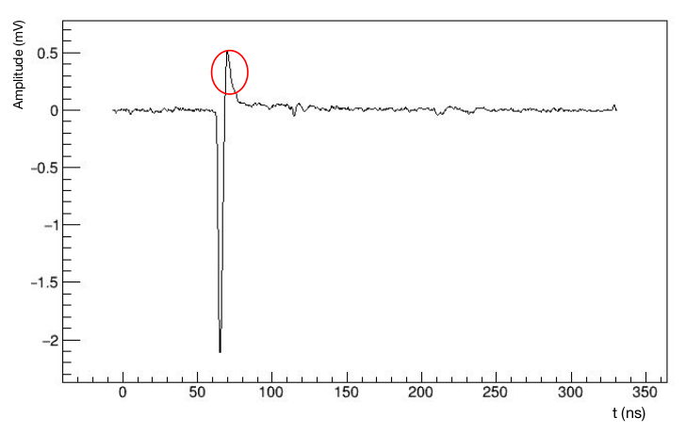
Charge method, 1
Another method to discriminate pile up is the integral method.
Integrating the signal of the SC, it is possible to obtain the value of the charge of the crossing particle,
from which discriminating single and pile up events.
The signal integral is computed excluding the samples with amplitude > baseline + 2 st.dev
overshoot
baseline
Credits to Marco Bon
In this way we remove the positive overshoot, a positive peak of the signal due to electronics which is different from event to event.
G. Ubaldi
G. Ubaldi

Slide 22
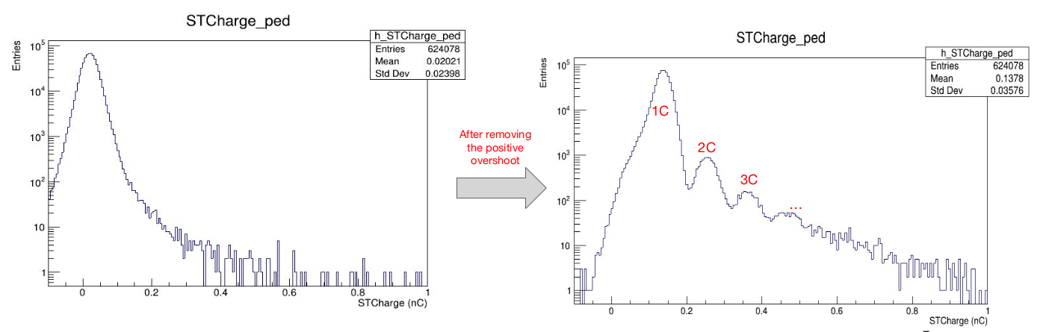
Charge method, 2
Removing overshooting, it is possible to distinguish charges of single events and pileup ones as separate peaks in the histogram of charges.
Credits to Marco Bon
To filter out pileup events, a cut can be introduced in the value of charge. In this case as c < 0.2 nC.
This method is developed by Giacomo Traini et al.
And under implementation on Shoe
G. Ubaldi

